Slide 1

Tribhuvan University
Institute of Engineering
Khwopa College of Engineering
A Major Project Presentation on
Secure Document Management System Using Steganography(Steganshield)
Date: 10th August 2026
SUPERVISED BY: Er. Dinesh Man Gothe
HOD, Computer Engineering
PRESENTED BY (Team ByteForge):
Aayush Khatri (KCE082BCT002)
Binit Maharjan (KCE082BCT012)
Biraj Khatri (KCE082BCT013)
Riyan Dhaubhadel (KCE082BCT032)

Slide 2
Presentation Outlines
Introduction
Problem Statement
Objectives
Tools & Technologies
System Architecture
Methodology
LSB Method
System Modules
Application Interface
Results and Discussion
Conclusion and Future Works
References
KHWOPA COLLEGE OF ENGINEERING|Major Project Defense|Secure Document Management System|10th August 2026

Slide 3
1. Introduction
Many people keep important documents like IDs, certificates, and records on their computer.
Normal storage only depends on the computer login, so it is not very safe.
Encryption can lock a file, but it still shows that a secret file exists.
Steganography hides data inside a normal image, so no one knows a secret is there.
Our project puts login, encryption, and steganography together in one app.
We first built it as a command-line tool, then as a PyQt5 desktop app.
KHWOPA COLLEGE OF ENGINEERING|Major Project Defense|Secure Document Management System|10th August 2026

Slide 4
2. Problem Statement
Most student projects show only one security idea, such as just login or just encryption.
They do not show how these methods can work together in one app.
Our project fills this gap by giving each layer a clear job.
Login checks who is allowed to use the system.
Encryption keeps the saved document unreadable to others.
Steganography hides a small secret, like a note or password, inside an image.
KHWOPA COLLEGE OF ENGINEERING|Major Project Defense|Secure Document Management System|10th August 2026

Slide 5
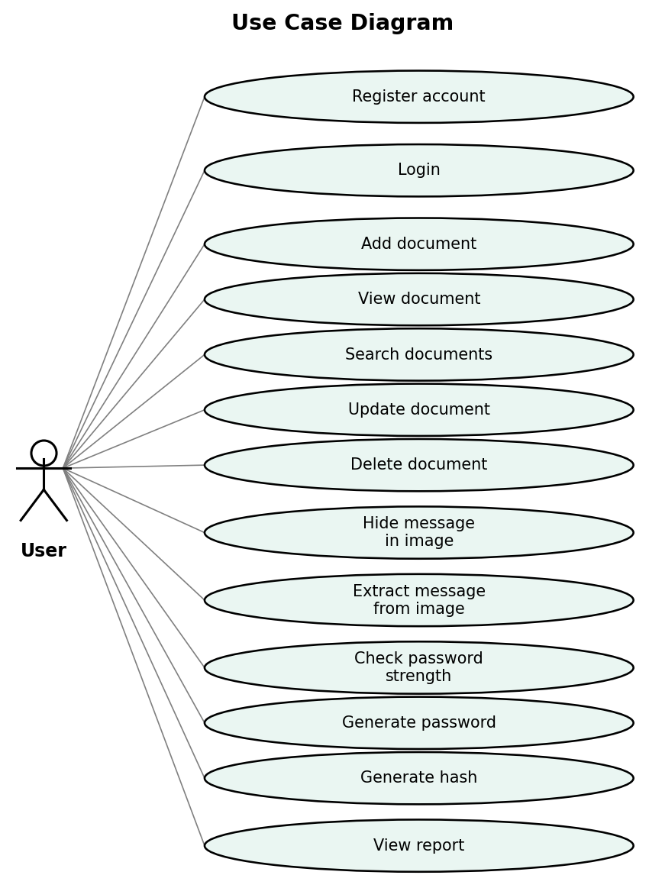
3. Objectives
Build a secure document app in Python using login, encryption, and steganography.
Store and manage documents in a safe way.
Hide secret data inside images with steganography.
Encrypt documents so they stay private.
Add login, search, and record-keeping features.
Add password tools: strength check, generator, and hash maker.
Make a command-line version first, then a PyQt5 GUI.
Figure 3.1: Use Case Diagram
KHWOPA COLLEGE OF ENGINEERING|Major Project Defense|Secure Document Management System|10th August 2026

Slide 6
4. Tools & Technologies
Language & Libraries
Interface, Storage & Tools
Python 3 — main programming language.
Pillow (PIL) — image processing for steganography.
cryptography (Fernet) — encrypts and decrypts documents.
hashlib — makes SHA-256, SHA-512, and MD5 hashes.
PyQt5 — builds the desktop interface.
JSON files — store user and document data.
Visual Studio Code — code editor for development.
Git and GitHub — version control and backup.
KHWOPA COLLEGE OF ENGINEERING|Major Project Defense|Secure Document Management System|10th August 2026

Slide 7
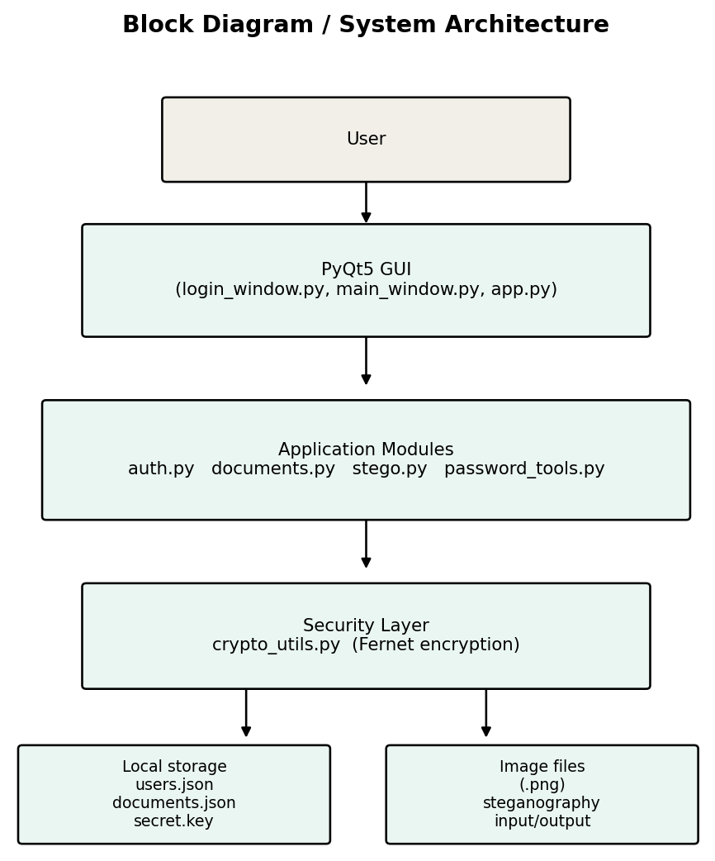
5. System Architecture
The app has a PyQt5 interface on top that the user works with.
The interface calls separate Python modules, one for each task.
Documents pass through the encryption layer before they are saved.
Data is stored in JSON files, and secrets are hidden inside PNG images.
Each layer has one clear job, which keeps the design simple and safe.
Figure 5.1: System Block Diagram
KHWOPA COLLEGE OF ENGINEERING|Major Project Defense|Secure Document Management System|10th August 2026

Slide 8
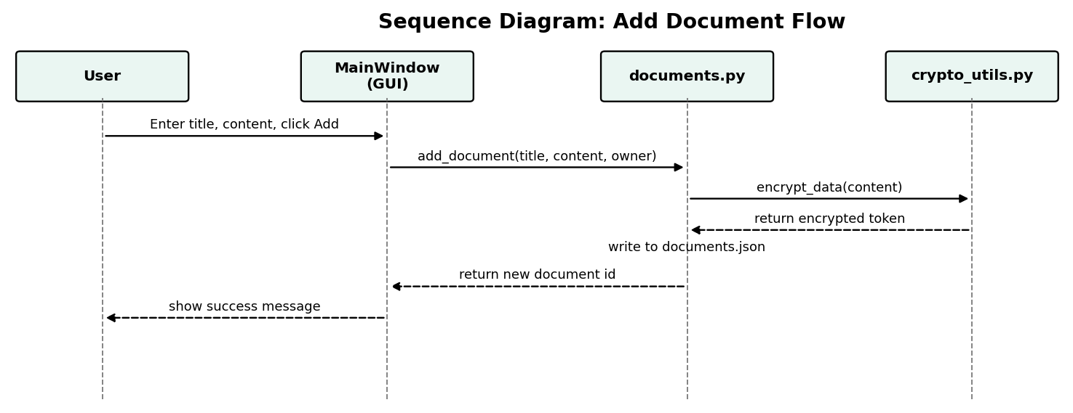
6. Methodology
We built and tested each module one by one, then joined them together.
Step 1 – Steganography: hide and read text in images (LSB).
Step 2 – Password tools: strength check, generator, and hashing.
Step 3 – Encryption: make keys and encrypt or decrypt files.
Step 4 – Login: store passwords safely with salted hashing.
Step 5 – Documents: add, view, search, update, and delete.
Step 6 – Join all modules in a command-line app.
Step 7 – Build the PyQt5 desktop app with tabs.
Figure 6.1: Add-Document Sequence Flow
KHWOPA COLLEGE OF ENGINEERING|Major Project Defense|Secure Document Management System|10th August 2026

Slide 9
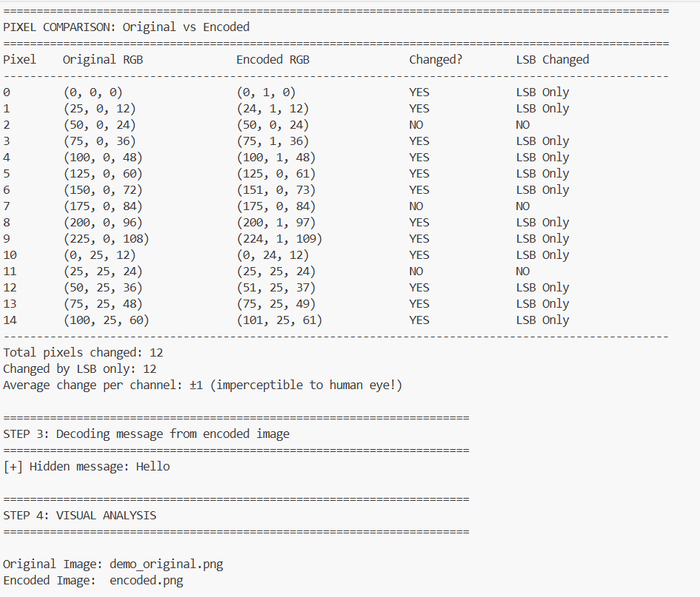
7. How Steganography Hides Data (LSB Method)
Each pixel has RGB values (e.g., 218, 145, 67). The message is hidden in the last bit (least significant bit) of each color channel.
Changing that last bit only shifts the color value by ±1 — invisible to the human eye.
One pixel = 3 bits of hidden data (1 bit each in R, G, B).
A special marker (11111110) tells the decoder where the hidden message ends
LSB alone isn't secure against analysis — that's why the message is encrypted with Fernet before it's hidden, combining steganography with real encryption.
Capacity note :
100×100 image → ~3,750 characters hideable
1000×1000 image → ~375,000 characters hideable
Fig 7.1 Original
Fig 7.2 encoded
Image looks identical — no visible difference.
KHWOPA COLLEGE OF ENGINEERING | Major Project Defense | Secure Document Management System|10th August 2026

Slide 10
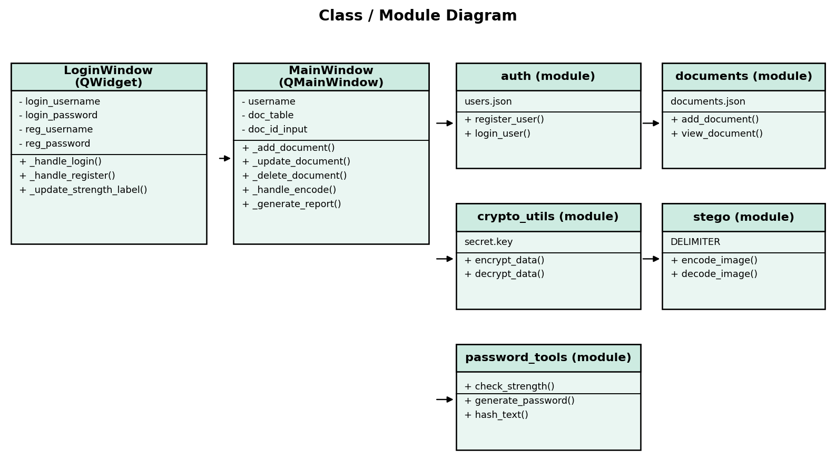
8. System Modules
auth.py — handles register and login with salted hashing.
documents.py — adds, views, searches, and edits documents.
crypto_utils.py — encrypts and decrypts data with Fernet.
stego.py — hides and reads text inside PNG images.
password_tools.py — checks, generates, and hashes passwords.
login_window.py and main_window.py — the PyQt5 screens.
stego_demo.py - shows how LSB works
Figure 7.1: Class / Module Diagram
KHWOPA COLLEGE OF ENGINEERING|Major Project Defense|Secure Document Management System|10th August 2026

Slide 11
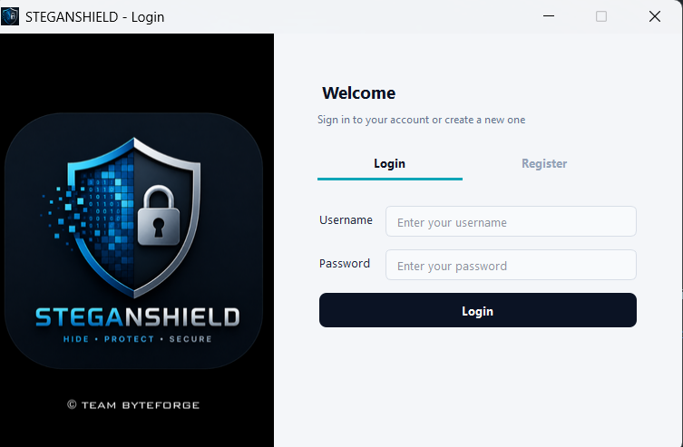
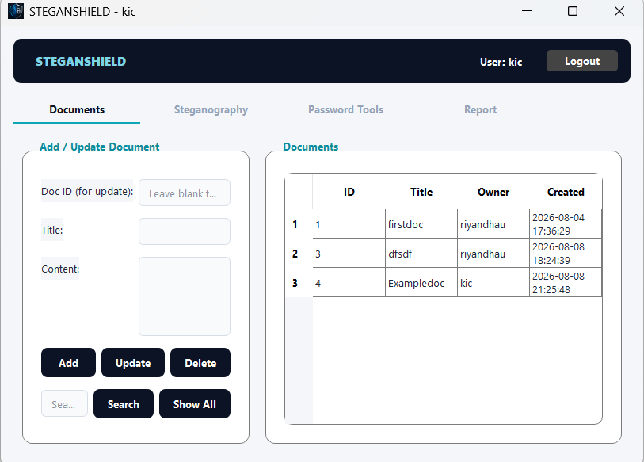
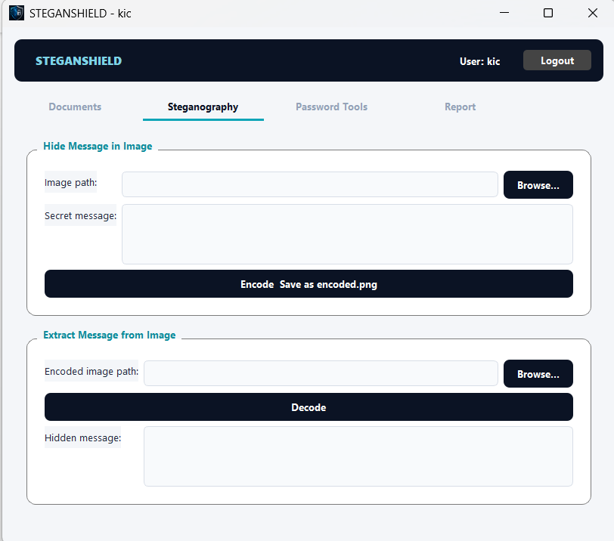
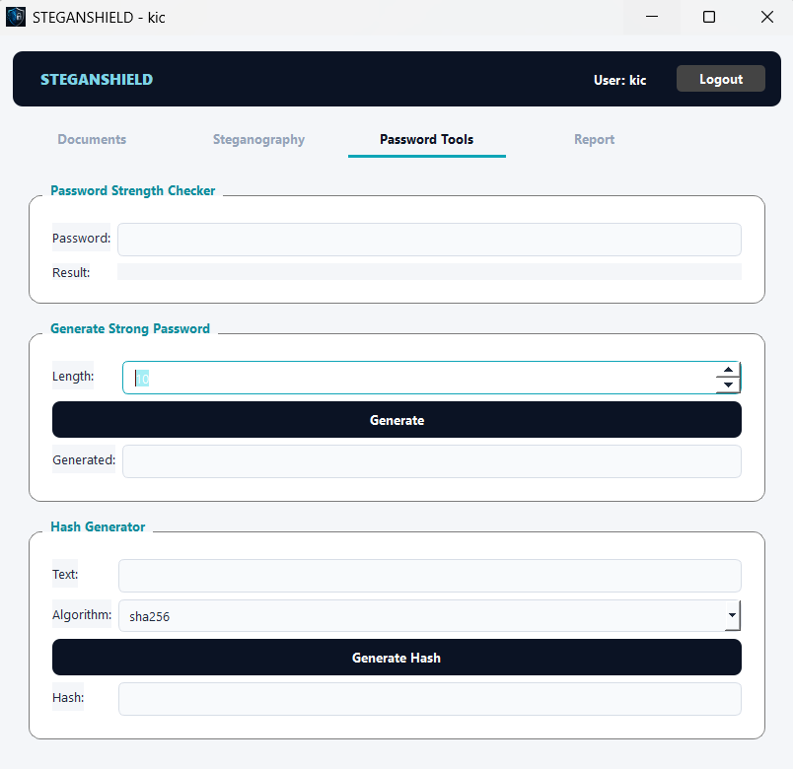
9. Application Interface
Screens from the PyQt5 desktop application:
Login / Register
Documents Tab
Password Tools Tab
Steganography Tab
KHWOPA COLLEGE OF ENGINEERING | Major Project Defense | Secure Document Management System|10th August 2026

Slide 12
10. Results and Discussion
Test Case | Expected Result | Status
Register a new user | User added to users.json with a hashed password | Pass
Login with correct credentials | Access granted to the main window | Pass
Login with incorrect password | Access denied, error shown | Pass
Add a document | Document encrypted, stored, and visible in the list | Pass
View a document | Content correctly decrypted and displayed | Pass
Search documents by title | Matching documents returned | Pass
Hide a message in an image | encoded.png produced, image visually unchanged | Pass
Extract a message from an image | Original hidden message correctly recovered | Pass
Check password strength | Correct rating and feedback shown | Pass
Generate a password | Password meeting all criteria produced | Pass
Table 6.1: Test Cases and Results
All three security layers passed testing, alone and together — login blocks unauthorized access, encryption keeps stored content unreadable, and steganography hides and recovers messages with no visible change to the image.
The hidden message size depends on the image size; when a message is too big, the system shows a clear error instead of cutting it off.
KHWOPA COLLEGE OF ENGINEERING|Major Project Defense|Secure Document Management System|10th August 2026

Slide 13
11. Conclusion and Future Works
Conclusion
Future Enhancements
The project shows layered document security inside one Python app.
Login, Fernet encryption, and LSB steganography each do a clear job, and all features passed testing.
We delivered both a command-line version and a PyQt5 desktop app.
Use a real database like SQLite instead of JSON files for scalability.
Add network support so users can share documents across devices.
Support more carriers such as audio, and add role-based access.
Add two-factor login and package the app as a standalone installer.
KHWOPA COLLEGE OF ENGINEERING|Major Project Defense|Secure Document Management System|10th August 2026

Slide 14
12. References
[1] Python Software Foundation, “hashlib — Secure hashes and message digests,” Python 3 Documentation. [Online]. Available: https://docs.python.org/3/library/hashlib.html
[2] Riverbank Computing, “PyQt5 Reference Guide.” [Online]. Available: https://www.riverbankcomputing.com/static/Docs/PyQt5/
[3] Python Cryptographic Authority, “Fernet (symmetric encryption),” cryptography documentation. [Online]. Available: https://cryptography.io/en/latest/fernet/
[4] “Pillow (PIL Fork) Documentation.” [Online]. Available: https://pillow.readthedocs.io/
[5] K. Moriarty, B. Kaliski, and A. Rusch, “PKCS #5: Password-Based Cryptography Specification Version 2.1,” RFC 8018, IETF, Jan. 2017.
[6] Team ByteForge, “SecureDoc — Project Source Code,” GitHub repository. [Online]. Available: https://github.com/RiyanDhau/securedoc.git
KHWOPA COLLEGE OF ENGINEERING|Major Project Defense|Secure Document Management System|10th August 2026

Slide 15
A MAJOR PROJECT PRESENTATION · TEAM BYTEFORGE
THANK YOU!
Questions & discussion welcome — Secure Document Management System Using Steganography
Secure Document Management System Using Steganography
BYTEFORGE

